Slide 1


Telecom Churn Prediction
Eshanya
Data Scientist at TuringMinds.ai

Slide 2
Introduction
TELECOM CHURN PREDICTION
Problem Statement
System Design
Agenda
Preprocessing, Featuring Engineering and EDA (Visualization)
ML Classification Models
Deployment- Streamlit
Conclusion

Slide 3
Introduction
TELECOM CHURN PREDICTION
Telecom companies are facing a growing challenge of customer churn, which refers to the process where a customer stops doing business with a company. In the telecom industry, customer churn is a significant problem as acquiring new customers is more expensive than retaining existing customers. This problem is exacerbated by the intense competition in the telecom market, where customers have a wide range of options to choose from.
Customer churn can have a significant impact on a telecom company's financial performance. Losing customers means a loss of revenue. Therefore, reducing customer churn is essential for the telecom industry's success and long-term profitability.
We can tackle this issue, using machine learning and data analysis techniques to predict which customers are at high risk of churn. By identifying these customers, companies can take proactive measures to retain them, such as offering personalized promotions, improving customer service, and addressing their concerns. This approach can help telecom companies reduce churn, increase customer satisfaction, and improve their overall business performance.

Slide 4
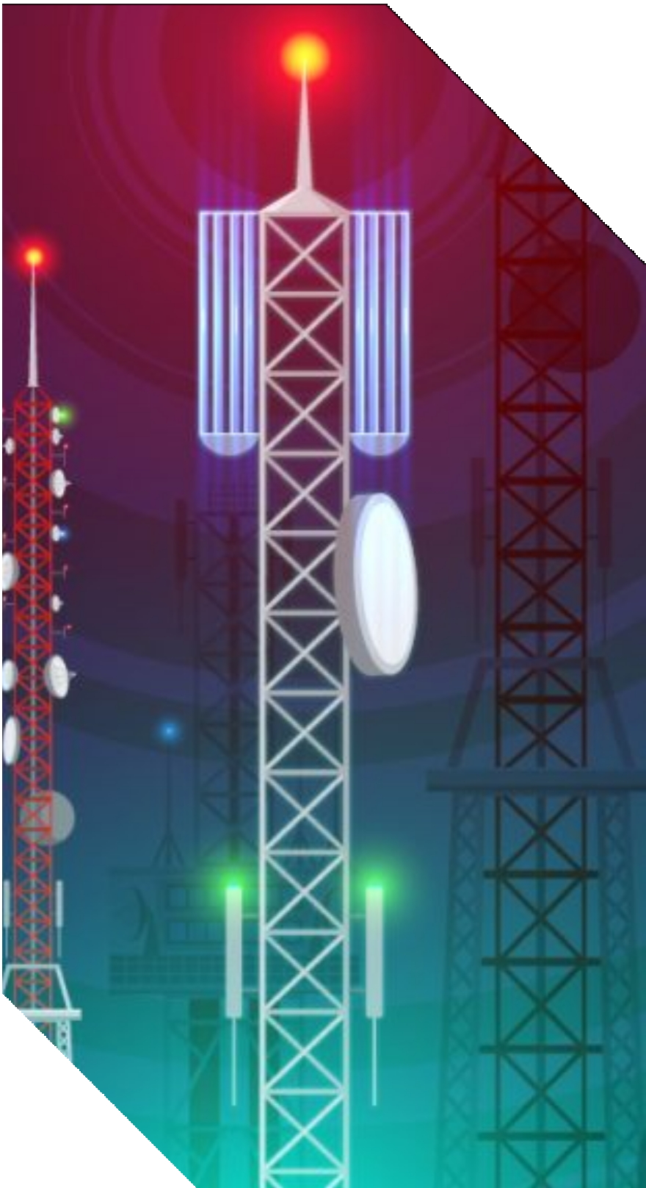
Problem Statement
TELECOM CHURN PREDICTION
"How can a telecom company reduce customer churn rate and increase customer retention by identifying the factors that contribute to churn and implementing effective retention strategies?"

Slide 5
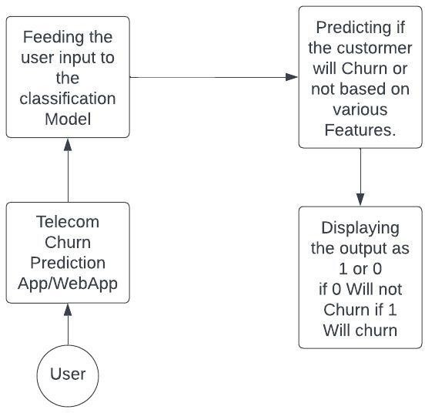
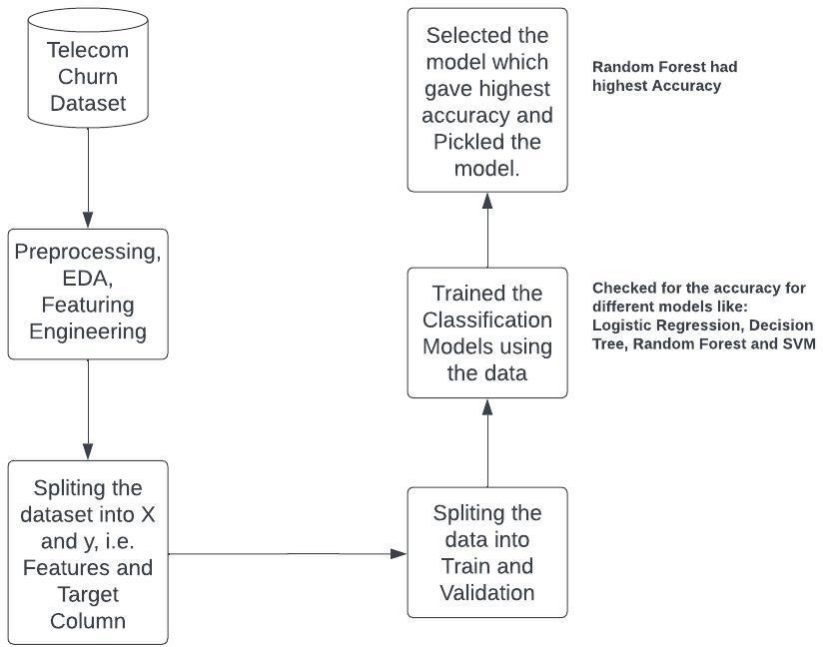
System Design
Backend
User Interface

Slide 6
TELECOM CHURN PREDICTION
Preprocessing, Featuring Engineering and EDA (Visualization)
Raw Data:-

Slide 7



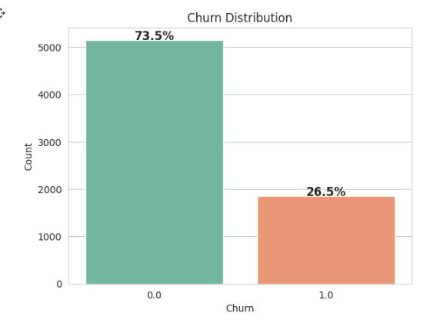
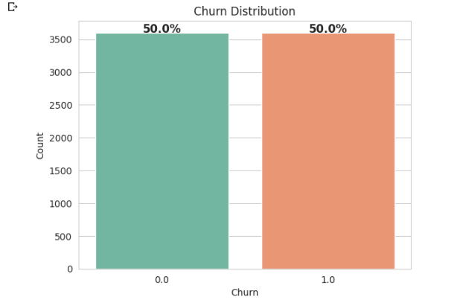
Preprocessing:-
Label Encoding categorical variables: converting categorical variables to numerical representation that can be used in machine learning models.
Data normalization or scaling: transforming the data to a common scale to avoid bias towards features with higher magnitude. Eg:- MinMaxScalar
Handling inconsistency in columns, eg:- Target column: RandomOverSampler technique is used to balance the class distribution of the target column

Slide 8



Feature Engineering:-
Creation of new features from the existing features:- train['MonthlyChargesPerTenure'] = train['MonthlyCharges'] / train['tenure'] train['TotalChargesPerTenure'] = train['TotalCharges'] / train['tenure']
Feature Selection:- Selecting top 10 highly correlated features using Chi2
So the Final 10 features are:- [tenure, OnlineSecurity, OnlineBackup, DeviceProtection, TechSupport, Contract, MonthlyCharges, TotalCharges, MonthlyChargesPerTenure, TotalChargesPerTenure]

Slide 9

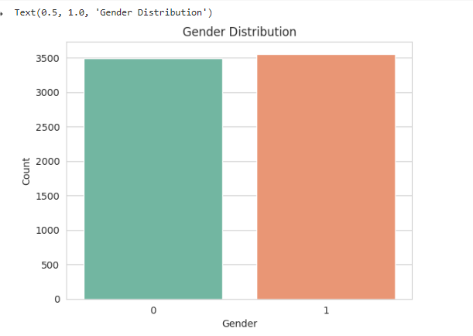
Exploratory Data Analysis and Visualization:-
Summarize the data: Calculate summary statistics such as mean,
median, mode, standard deviation, and range to get an overview of the
data.
Gender Distribution - About half of the customers in our data set are
male while the other half are female

Slide 10
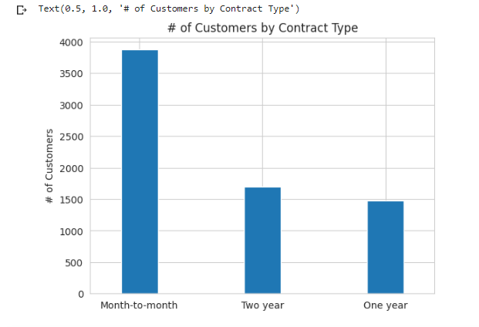
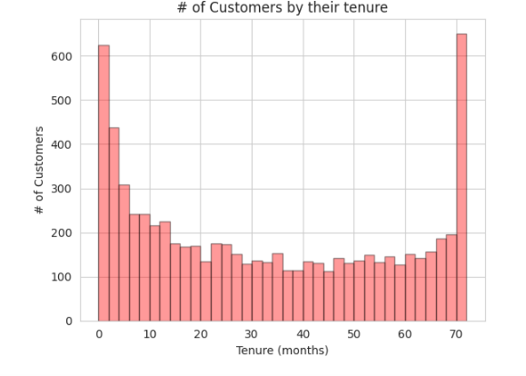
A lot of customers have been with the telecom company for just a month, while quite a many are there for about 72 months
Lets look into different kinds of Contracts

Slide 11
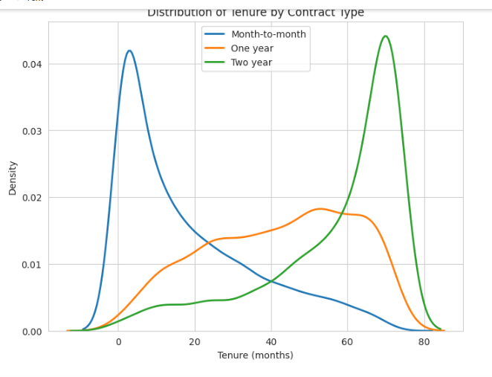
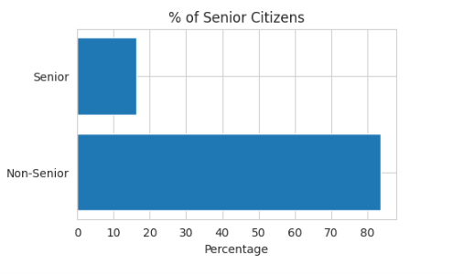
According to the graph below, most monthly contracts run for 1-2 months, although two-year contracts typically endure for roughly 70 months. This demonstrates that clients who sign longer contracts are more devoted to the business and have a propensity to stick with it.
Only 16% of the clients are seniors, according to the statistics. The statistics shows that young people make up the majority of the clientele.

Slide 12
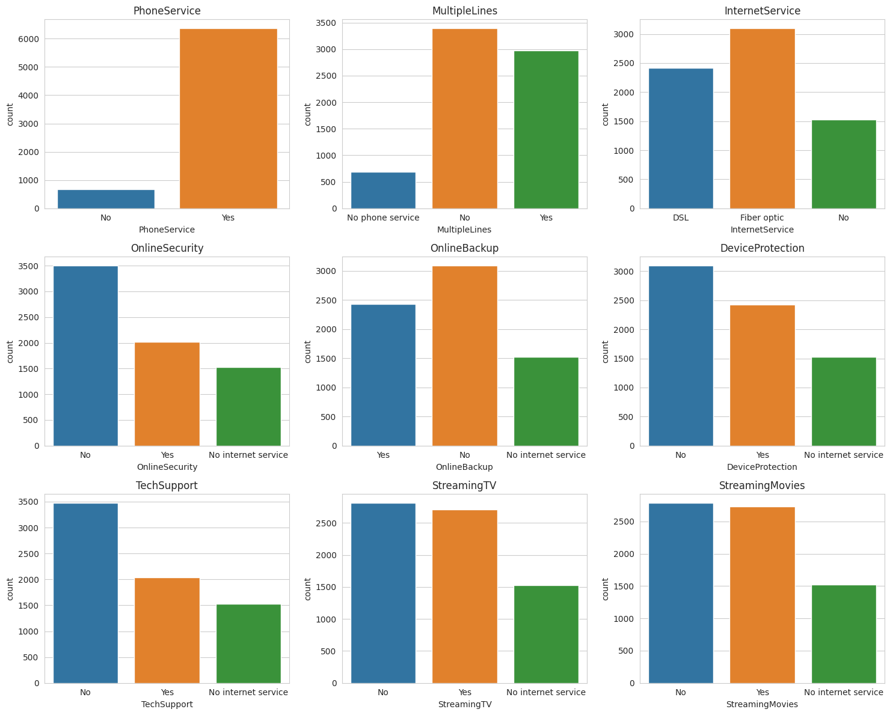
The graphs below show all of the services that the clients have been utilising.

Slide 13
TELECOM CHURN PREDICTION
ML Classification Models
Logistic Regression: This model is a linear algorithm that is used to predict the probability of a binary target variable. It is simple to implement and interpret, and can be extended to multi-class problems.
Decision Trees: Decision trees are a popular model that is used to classify data by recursively splitting the data based on the features that best separate the classes. Decision trees can be easily visualized and interpreted, and can handle non-linear relationships between features and target variables.
Random Forests: Random forests are an ensemble method that combines multiple decision trees to improve the accuracy of the model. The individual trees are built on random subsets of the data and features, and the final prediction is made by aggregating the predictions of all the trees.
Support Vector Machines (SVMs): SVMs are a powerful model that can be used to classify data by finding the hyperplane that best separates the classes. SVMs can handle non-linear relationships between features and target variables by using kernel functions.

Slide 14
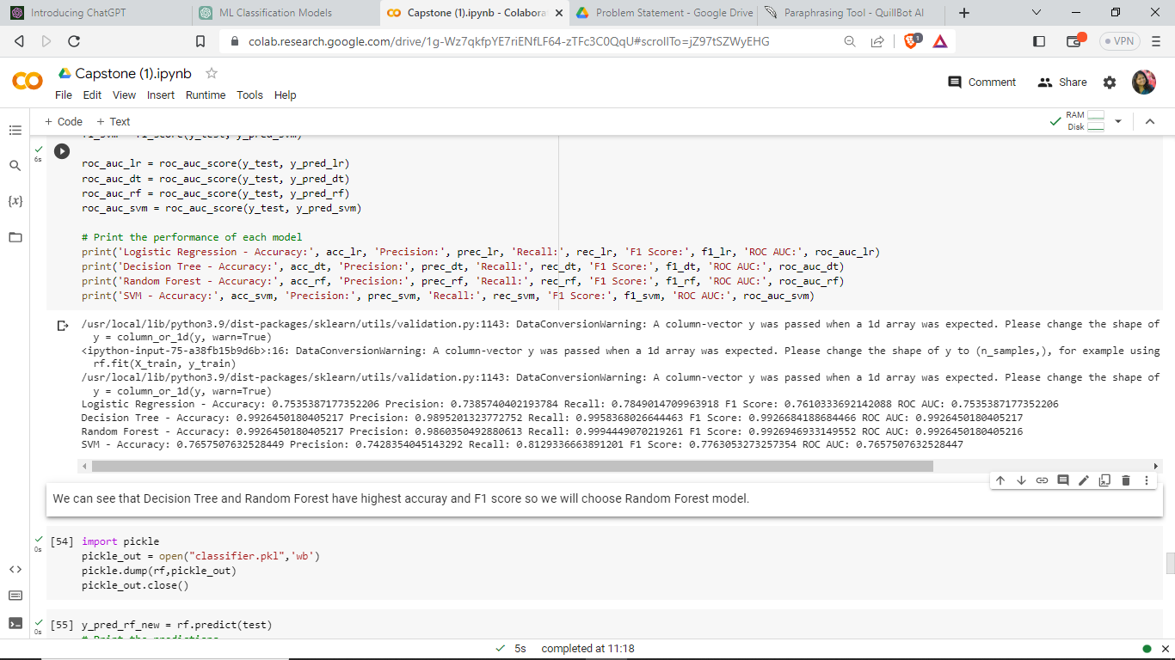
Results:-
We can see that Decision Tree and Random Forest Modes have highest accuracy and F1 score so we will choose Random Forest for Front end development (Streamlit). We can download the model in pickle format.

Slide 15

TELECOM CHURN PREDICTION
Deployment
Streamlit has been used to deploy the project.
Streamlit is an open-source Python framework that allows developers to easily create and share interactive web applications for data science and machine learning. It provides a simple way to create custom web interfaces for your Python code, allowing you to quickly prototype and deploy machine learning models, data visualizations, and other data-driven applications.

Slide 16
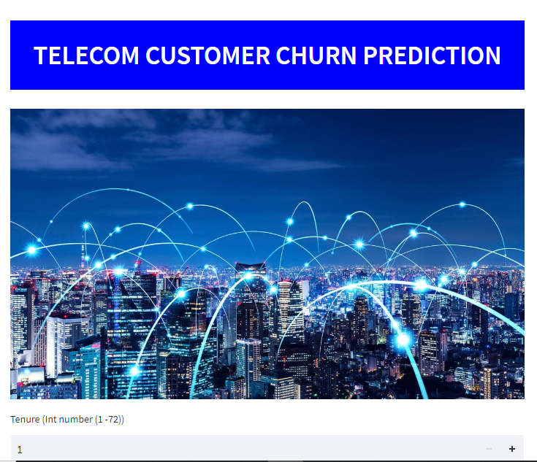
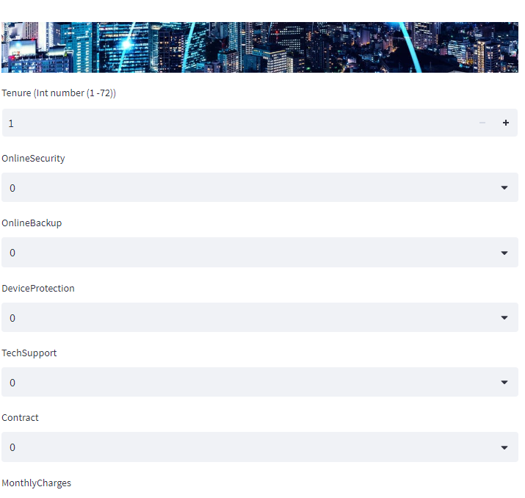
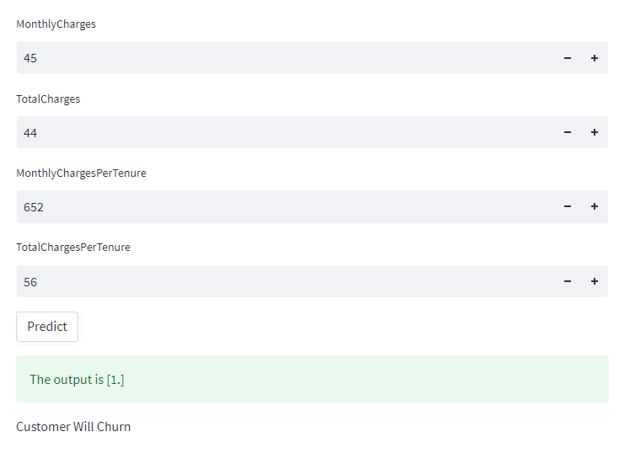
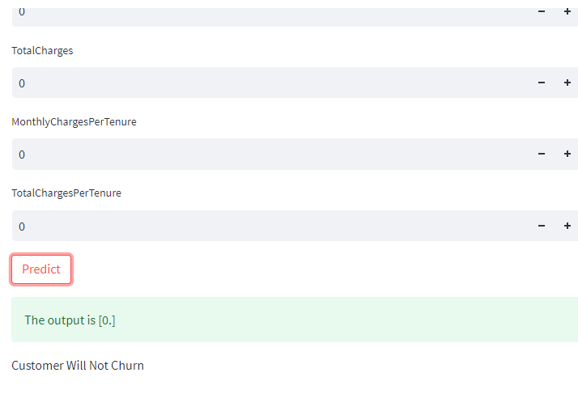
SCREENSHOTS

Slide 17
TELECOM CHURN PREDICTION
Conclusion
Hence the machine learning random forest classification model is a powerful tool for predicting customer churn in the telecom industry. By analysing customer behaviour data and identifying key factors that contribute to churn, the model can help companies take proactive measures to retain their customers and reduce their churn rate. Moreover, with the addition of a Streamlit front-end user interface, telecom companies can easily deploy and use this model to make data-driven decisions in real-time. The Streamlit interface provides an intuitive and user-friendly way to interact with the model's predictions.
Overall, the combination of machine learning and Streamlit can help telecom companies stay ahead of the competition by identifying and addressing customer churn before it becomes a problem.

Slide 18
THANK YOU

